Slide 1
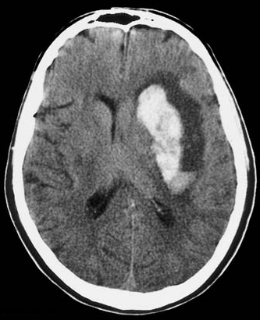
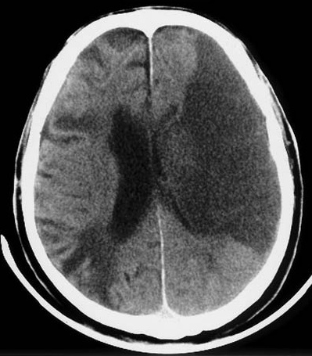
Basics of CT brain
Dr. Aminur Rahman
FCPS (Med), MD(Neuro) ,FINR (Switzerland), Member ACP (USA)
Fellow Interventional Neuroradiology (Thailand)
Assistant Professor
Department of Neurology
Sir Salimullah Medical College

Slide 2
Medicine is learned by bedside and not in the classroom. Sir William Osler (1849-1919)

Slide 3
Indications of CT Scan of brain
Head injury or skull fractures,
Stroke,
Suspected hydrocephalus,
Suspected intracranial hematoma,
Evaluation of Headaches,
Diseases or malformations of the skull.
Initial evaluation for space-occupying lesions
Seizures and
Unexplained change in mental status.

Slide 4
Contraindications of CT scan of Head:
CT scan has no absolute contraindications.
Caution is indicated in pregnant women, particularly during the first trimester to avoid fetal abnormalities.
Repeated x-ray exposure may increase the patient's risk for cancer

Slide 5
Advantage of CT scan (over MRI)
Cheaper.
More available.
Quick. It takes about few minute. So it is the method of choice for restless or critical patients and for babies.
Bony abnormalities and calcifications can be visualized.
It can detect acute (< 2 weeks) haemorrhage.

Slide 6
Disadvantage of CT scan
Radiation hazard, so relative contraindicated in pregnancy.
Good resolution cannot be achieved in all planes. In fact, only axial planes have good resolution.
Posterior fossa of head and spinal canal are not well visualised because X-ray cannot penetrate bone.
Poorer resolution. CT cannot detect lesions< 5 mm, whereas MRI can detect up to 1 mm. But now a days 64 slice CT scan can take 1 mm section.
CT cannot detect inflammatory lesions.
In Infarct CT may be negative for first 6 hrs.

Slide 7
Attenuation Coefficient:
The tissue contained within each image unit (called a pixel) absorbs a certain proportion of the x-rays that pass through it (e.g., bone absorbs a lot, air almost none). The ability to block x-rays as they pass through a substance is known as Attenuation.

Slide 8
Attenuation Coefficient:
In CT, these attenuation coefficients are mapped to an arbitrary scale of between −1000 Hounsfield units (HU) (air) and +1000 HU (bone)

Slide 9
Box : Appearance and Density of Tissues on Cranial Computed Tomography
Appearance: Black → → → → → → → → → → White −1000 HU → → → → → → → → +1000 HU Air, fat, CSF, white matter, gray matter, acute hemorrhage, bone Important Densities: Air = −1000 HU Water = 0 HU Bone = +1000 HU CSF, Cerebrospinal fluid; HU, Hounsfield units.

Slide 10
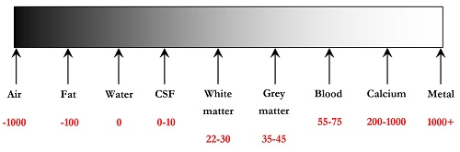
Figure Hounsfield scale ranging from -1000 to + 1000

Slide 11
Types of CT Scan
General: Usually CT head is of 3 types
Tissue window: Here soft tissue is highlighted.
Bony window: Here bone and calcifications are highlighted.
CT head with contrast: Blood vessels and highly vascularized tissue are visible.
Special CT scan of head:
Reconstructed coronal CT scan of head,
3D reconstructed CT scan of head.
Plain/Reconstructed CT angiogram of head.

Slide 12
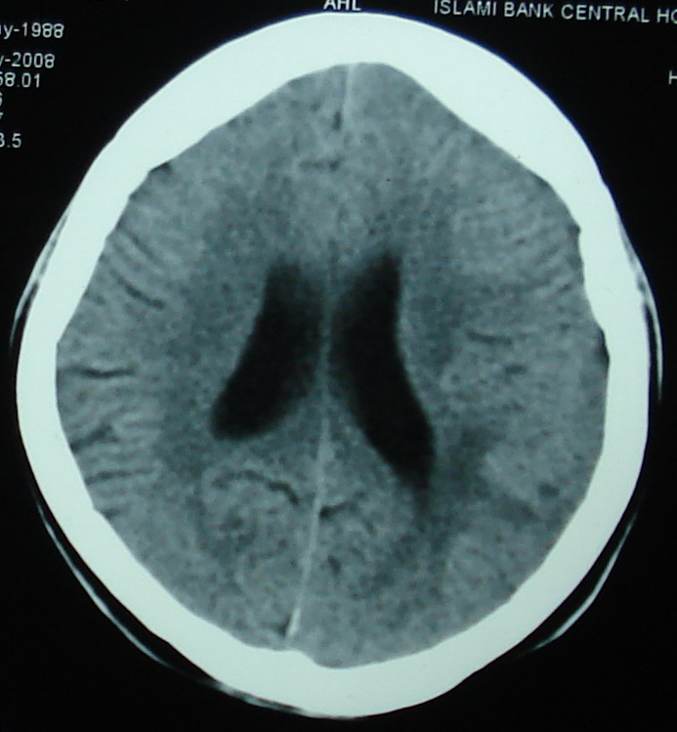
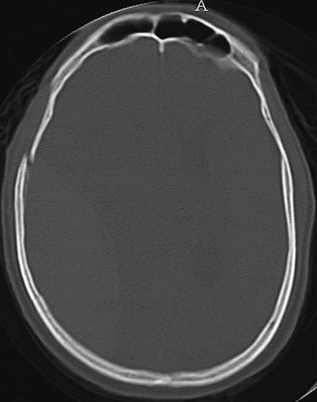
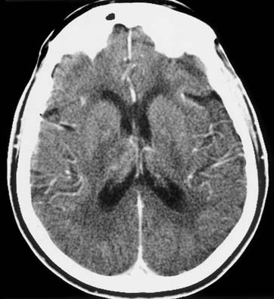
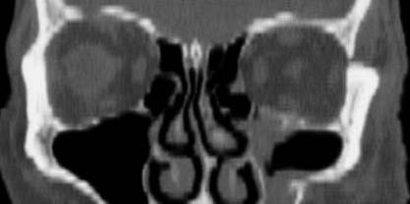
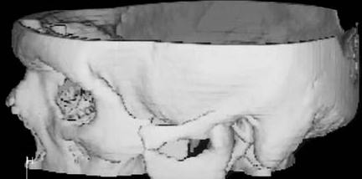
Soft tissue window/plain CT
Bony window
IV Contrast CT
Reconstructed coronal CT scan of head
3D Reconstructed CT scan of head

Slide 13
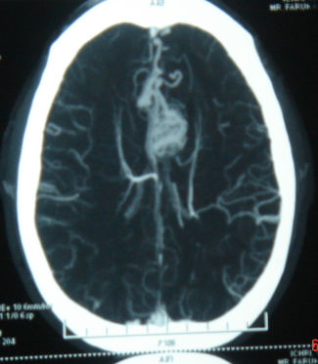
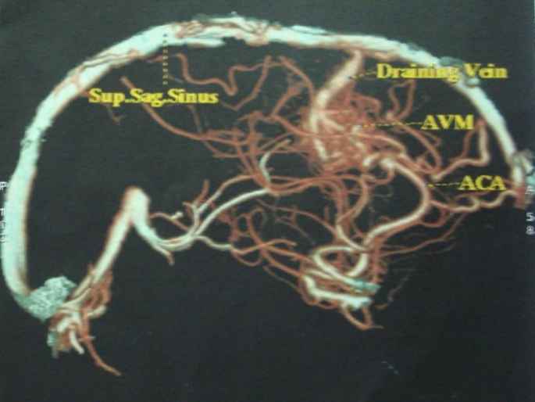
CT angiogram of head
Plain CT angiogram of brain
Reconstructed CT angiogram of brain

Slide 14
What to see:
Soft tissue/brain parenchyma
Ventricle
Brain oedema
Subarachnoid space
Subdural space
Extradural space
Bones/calcification

Slide 15
CT scan of Head is expressed in terms of density:
Isodense: For CT head, normal parenchyma is isodense.
Hypodense: Darker than normal parenchyma.
Hyperdense: Whiter than normal parenchyma.

Slide 16
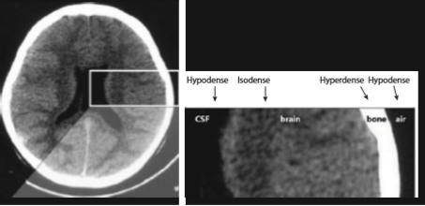
Densities in CT Scan

Slide 17
Hypodense (black) lesions
Air, e.g., In nasal cavity, paranasal sinuses
Fluid, except blood, e.g., CSF, water.
Infarct.
SOL.
Old haemorrhage (>2-3 weeks).

Slide 18
Hyperdense (white) Lesions
Bones
Calcification
Acute haemorrhage: Blood pigments ( bilirubin, biliverdin) are radio-opaque
Contrast material.

Slide 19
Physiological calcifications
Falx cerebri
Choroid plexus ( suspended in the post. horns of lateral ventricle)
Pineal gland (in third ventricle)
Basal ganglia ( speckle calcifications)

Slide 20
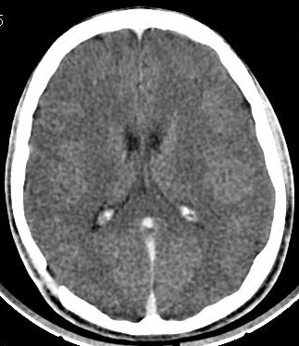
Physiological calcifications
Pineal gland
Choroid plexus
Falx cerebri

Slide 21
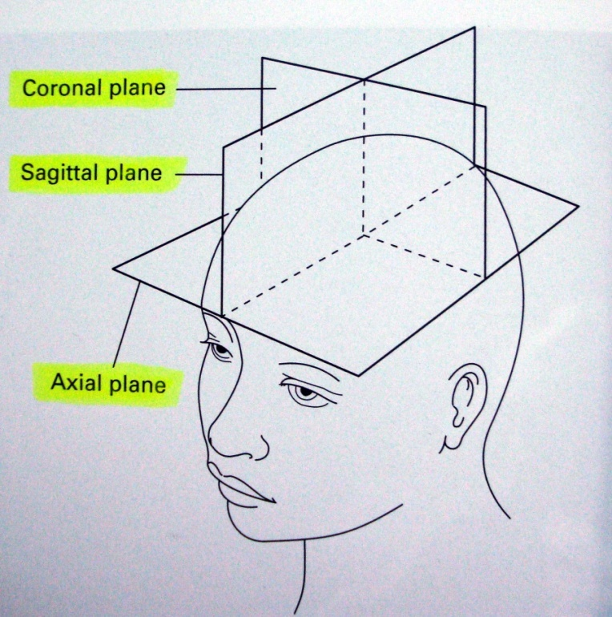
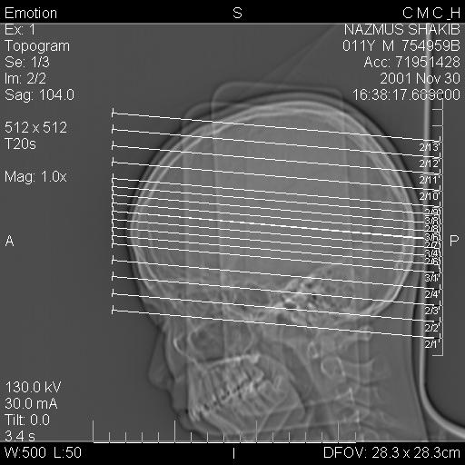
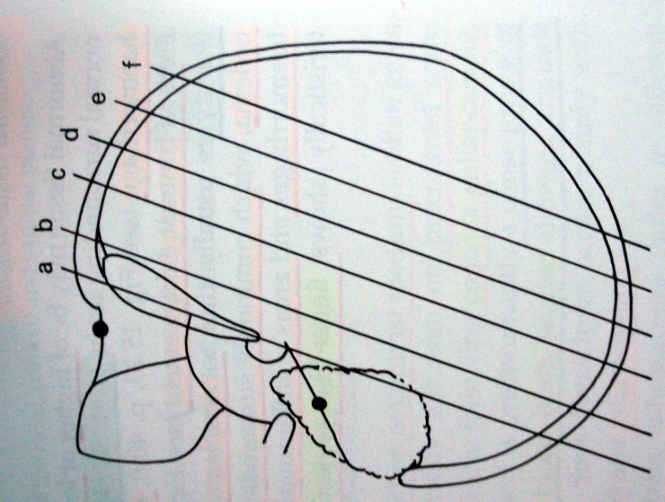
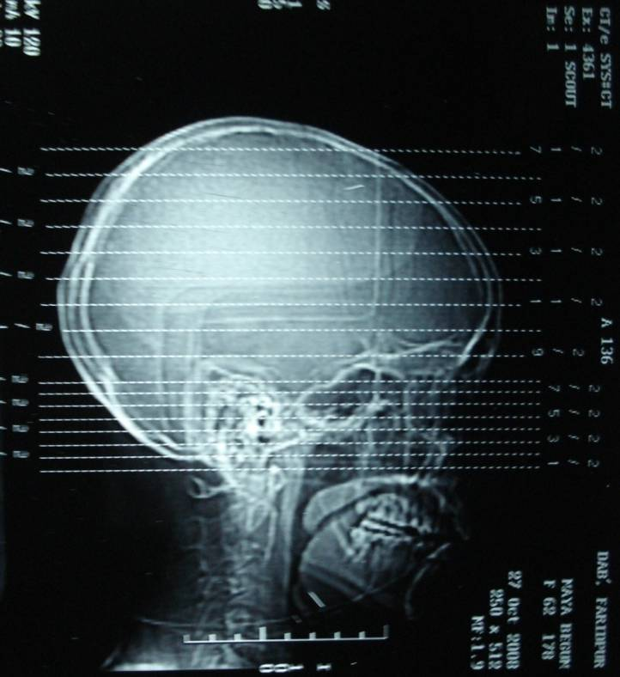
Sections in CT scan

Slide 22
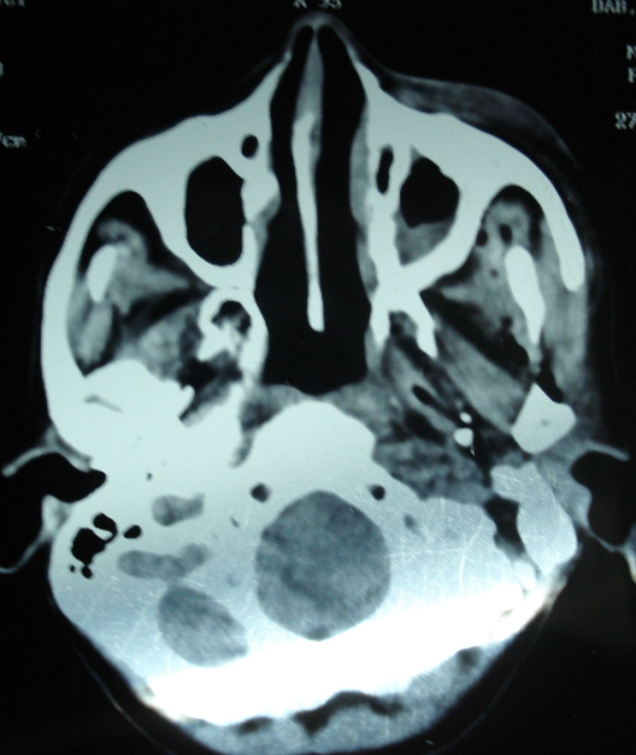
1st section from base of the skull
Nasal septum
Maxillary sinus
Oral cavity
Cervico-medullary junction
Foramen megnum
Base of the skull

Slide 23
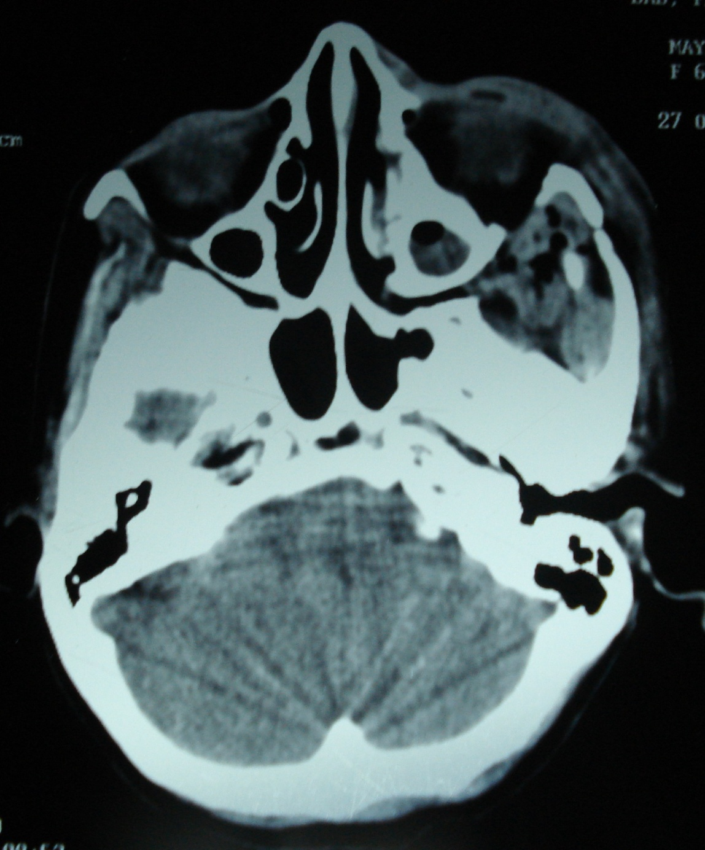
2nd section from base of the skull
Eye ball
Mastoid air cells
Cerebellum

Slide 24
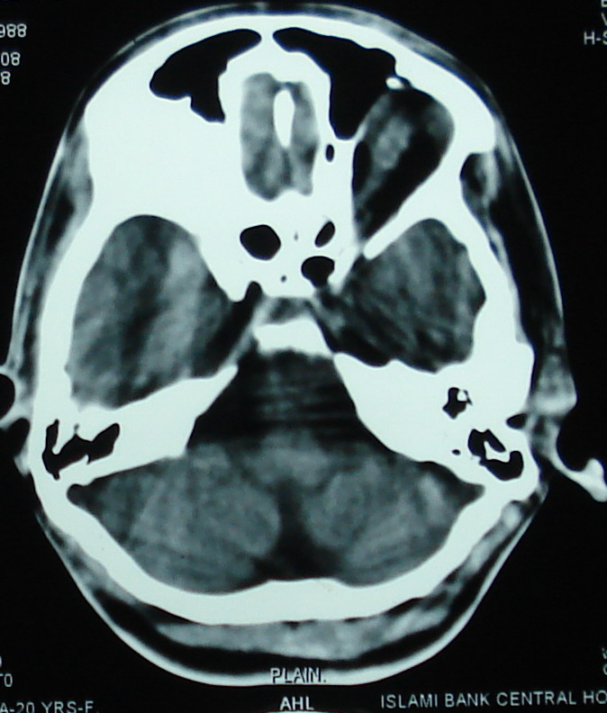
3rd section
At the level of Medulla
Frontal air sinus
Sphenoidal air sinus
Temporal lobe
Medulla oblongata
Cerebellum
Scalp

Slide 25
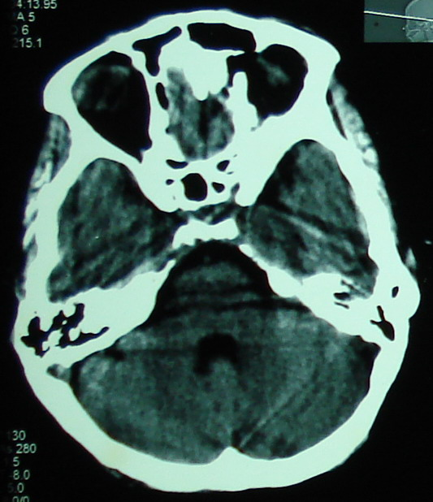
4th section
At the level of lower pons
Orbital cavity
Sphenoidal air sinus
Ant. clinoid
Temporal lobe
Dor. sela
Lower Pons
4th ventrical
Cerebellum

Slide 26
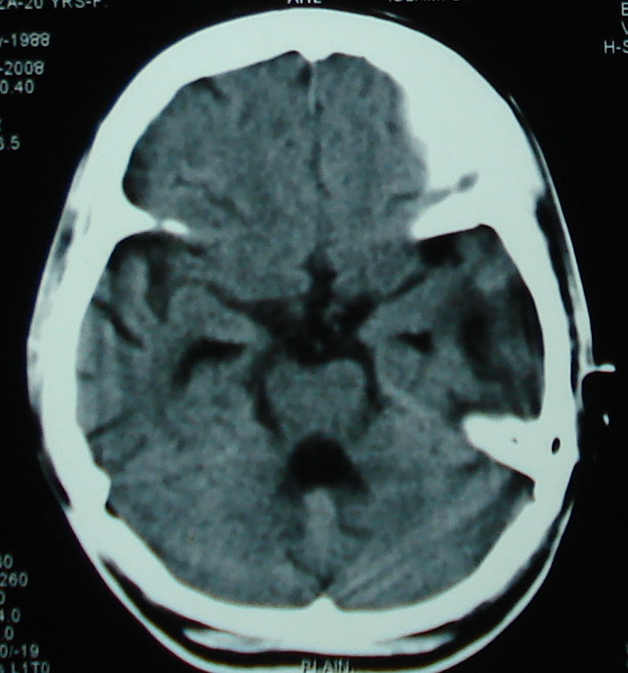
5th section
At the level of mid Pons
Interhemispheric fissures
Chiasmatic / basal cistern
Temporal horn of lat. ventrical
Mid Pons
4th ventrical
Vermis of cerebellum

Slide 27
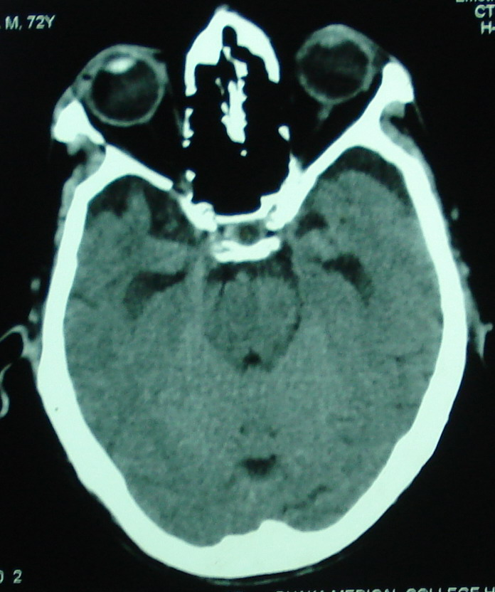
6th section
Nose
Eye ball
Temporal lobe
Pituitary fossa
Basilar artery
Superior Pons
4th ventrical
At the level of superior pons

Slide 28
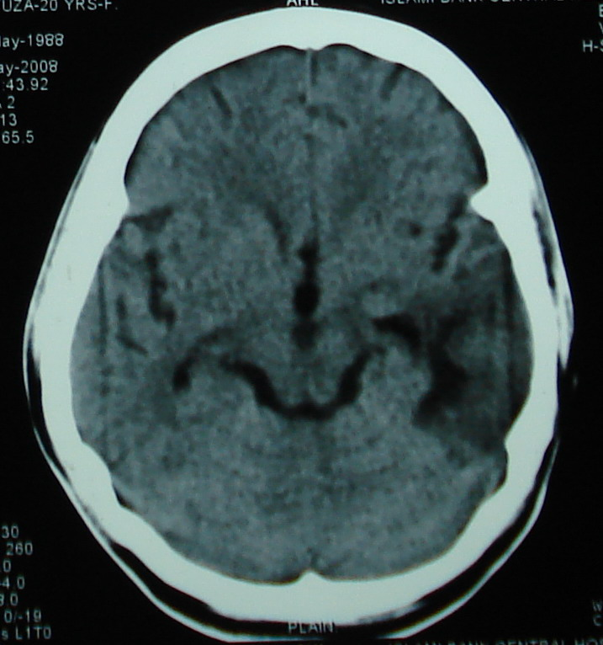
^{7th} section
At the level of Midbrain
Frontal lobe
Sylvian fissure
3rd ventrical
Temporoparietal lobe
Midbrain
Quadrigeminal cistern
Part of cerebelum & occipital lobe

Slide 29
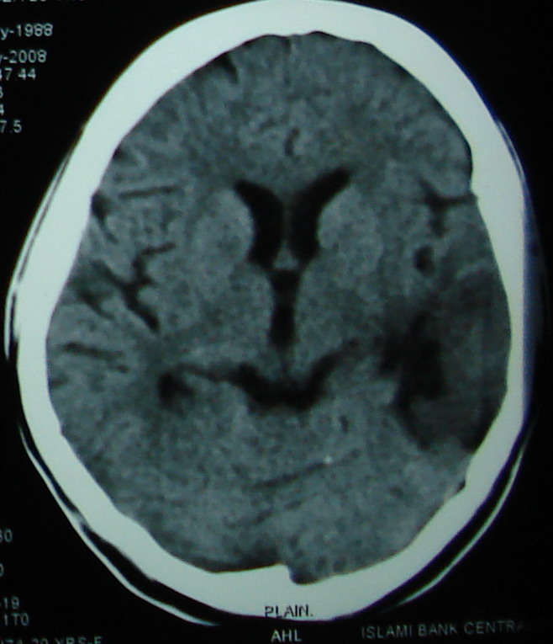
8th section
Ant. / Frontal horn of lateral ventrical
Septum pellucidum
Fornix
3rd ventrical
Trigone
Occipital sinus in falx cerebelli
Internal occipital protuberance

Slide 30
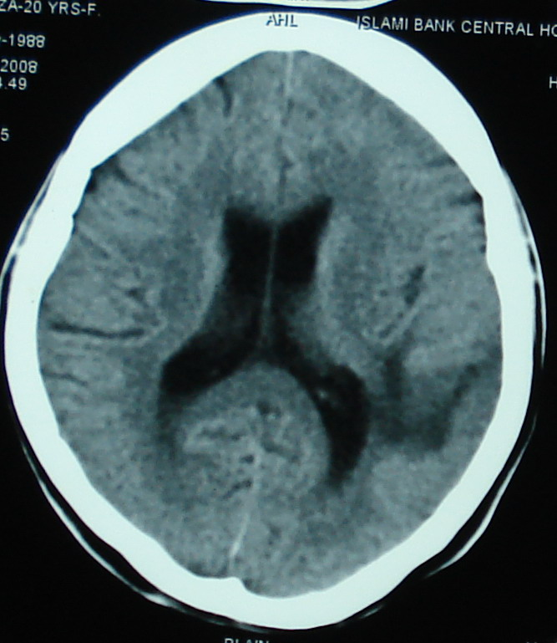
^{9th} section
Falx cerebri
Frontal lobe
Lateral ventrical
Body of lateral ventricle with choroid plexus
Parietal lobe
Post/Occipital horn of lateral ventricle
Occipital lobe

Slide 31
^{10th} section
Falx cerebri
Gyrus
Sulcus

Slide 32
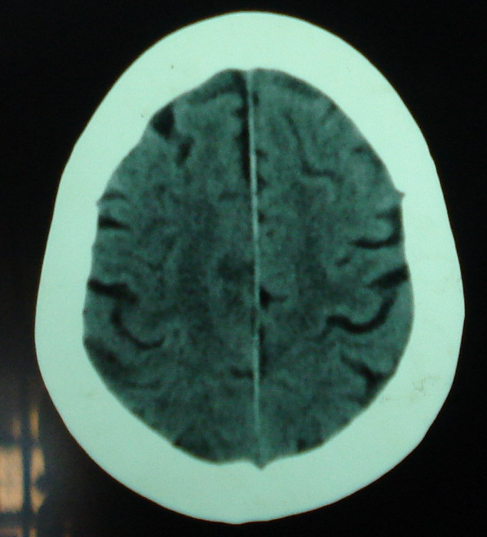
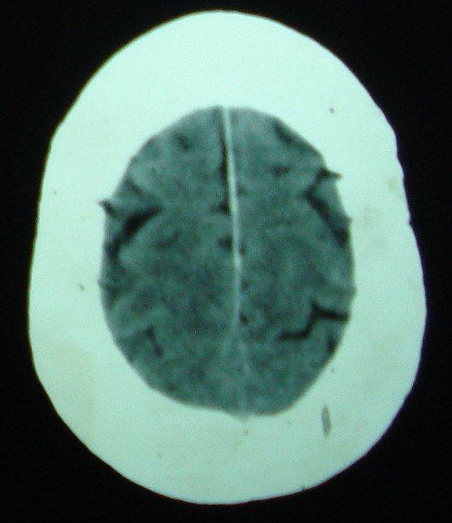
11th, 12th section

Slide 33
Common abnormalities (95%):
Abnormalities in CT Scan
Un Common abnormalities (5%):
Infarct : a. Cortical b. Sub-cortical
c. Cerebellar d. Brainstem
Haemorrhage,
Space occupied lesion (SOL)
Hydrocephalus: a. Obstructive. b. Non obstructive.
Diffuse brain oedema.
Abnormal calcification.
Rare SOL.

Slide 34
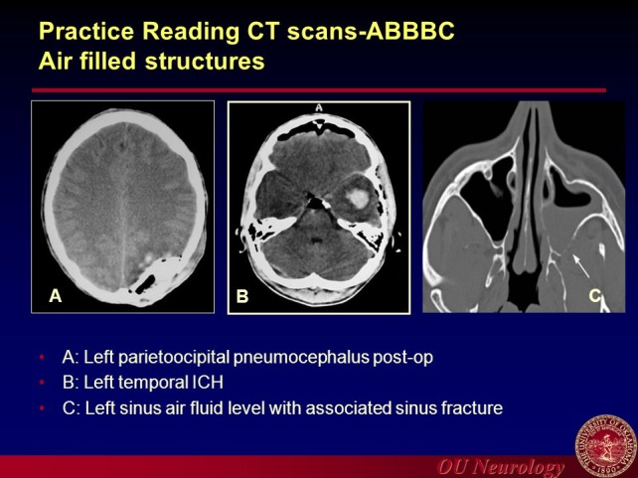
Approach to Review a CT scan- AABBCS (Mnemonic)
A-Asymmetry
A- ir-filled structures (artifacts/sinuses, mastoid air cells)
B-Blood (subarachnoid, intracerebral, subdural, epidural hematoma)
B- Brain tissue (infarction, edema, masses, brain shift
C- CSF spaces (sulci, ventricles, cisterns, hydrocephalus, atrophy)
S–Skull and scalp (fractures, Skull metastases)

Slide 35
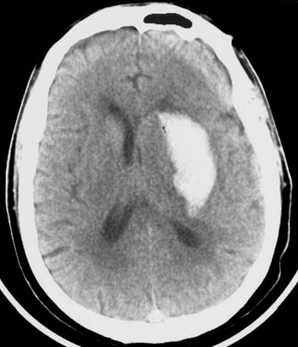
Note: In CT scan all features are expressed in density ( Hypo-dense, Iso-dense, Hyper-dense
Infarct
Haemorrhage

